Slide 1
How to Use The Peer Educator Toolkit
Emily E. Gentile
University of Delaware Preconception Peer Educator & Student Nurse, 2013

Slide 2
What is This “Toolkit” You Keep Talking About?
“Toolkit” is defined as “A set of tools designed to be used together for a particular purpose.”
Peer Educator Toolkit: A set of resources for Peer Educators to utilize when performing outreach programs in the Delaware Community

Slide 3
How is the Toolkit Organized?
General Organization: The toolkit is organized by Target Audiences:
Communities
Young Women (“For Her”)
Young Men (“For Him”)
Teens
There is also a section for Peer Educators to educate themselves!

Slide 4
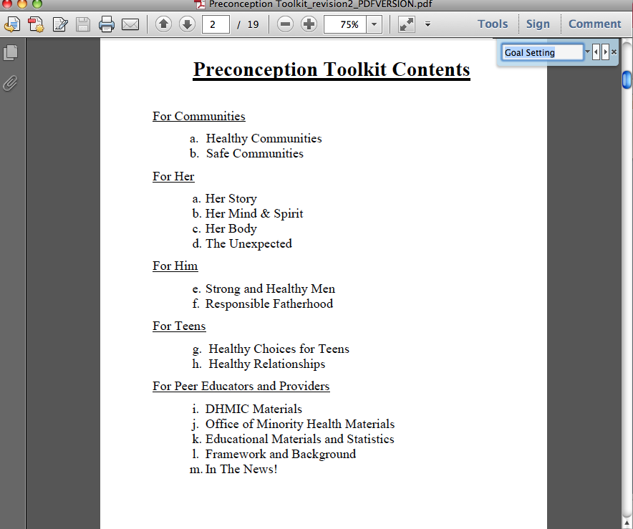
There are SO Many Resources, How do I find what I need?
When using the PDF version of the toolkit, press Control (Command on Macs) + F and a search box will show up to search for a specific topic.
You May also click on your target audience and sub-categories via the Table of Contents

Slide 5
I have the basics, now how do I actually put it into ACTION? {In the Community}

Slide 6
I have the basics, now how do I actually put it into ACTION? {In the Community}

Slide 7
What about on Campus?

Slide 8
How do I Make Sure I am Effective?
It is very important to evaluate each outreach program and its effectiveness.
The Office of Minority Health provides a guide on how to do just that! Check it out in the “For Peer Educators” section of the toolkit

Slide 9
Everyone Learns Differently
There are many different learning styles
Consider each style to ensure your message reaches the broadest base!
Visual: Powerpoints, Prezis, Banners, etc. will really catch the eye of people around you.
Tactile: Have handouts ready to go! The lifecourse game, “M&M STD Game”, and other small activities are great ways to interact with tactile learners!
Auditory: Talk to people! Create discussion based around your outreach topics.
It is a great idea to have 3 HEALTH MESSAGES that each PPE should try to convey to every person during an outreach.

Slide 10
Learning Styles Quiz
How do you learn best?

Slide 11
Questions/Comments?
THANK YOU!

