Slide 1
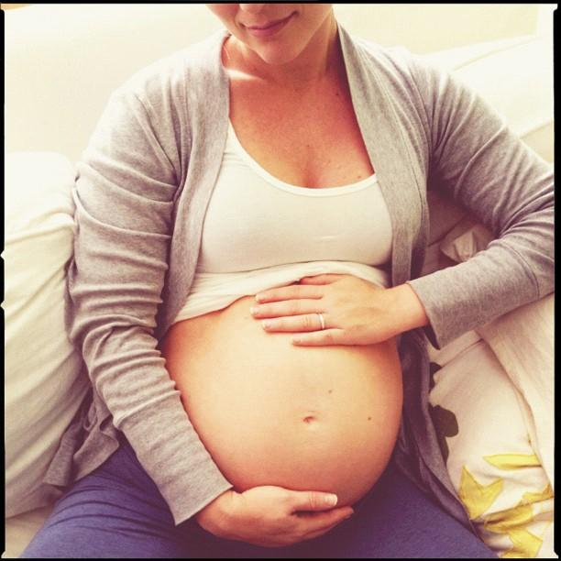
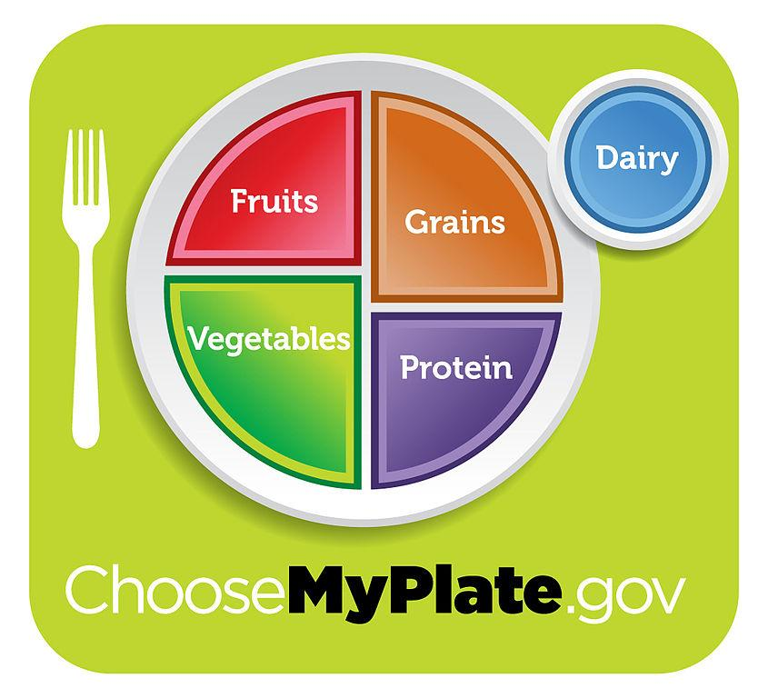
Nutrition During Pregnancy
Preconception Peer Educators
University of Delaware 2013

Slide 2
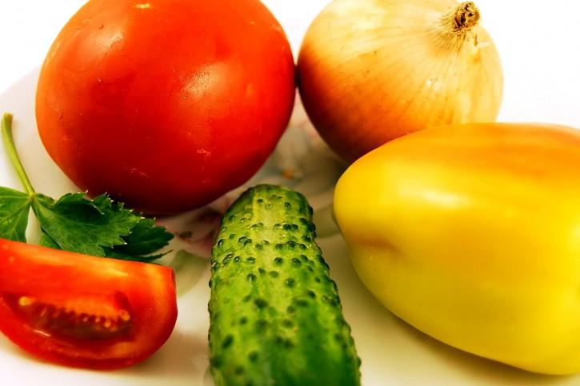
Pregnancy Nutrition
- A well balanced diet is essential to a healthy baby
- During 2nd and 3rd trimesters, the body needs about 300 extra calories per day
Meaning you are NOT eating for two!
- Not gaining enough weight during pregnancy can put your child at risk
Premature pregnancy --> Lung & heart problems
- Remember that your eating habits directly affect another person!

Slide 3
Pregnancy Nutrition (Cont'd)
- Should consume 75 to 100 grams of protein per day (2-3 servings of meat or legumes)
- Should consume 1000 mg of calcium (dairy)
- Should consume 27 mg of iron (whole grains, leafy greens)
- Should consume 85 mg of vitamin C (fruit, vegetables)
Notes:
One serving of meat is 3 oz and one serving of legumes is 1/2 cup

Slide 4
Folic Acid
- Folic acid is used to make extra blood the body needs during pregnancy
-ALL women of childbearing age should consume 400 mg a day
-Should start taking prior to getting pregnant even if you aren't trying to
-Foods that contain folic acid: leafy green vegetables, citrus fruits, beans, breads, cereals, rice and pastas
Notes:
The absence of folic acid increases the possibility of a neural tube defect (a defect in the development of the spinal cord) ex.) spina bifida

Slide 5
Foods to Avoid During Pregnancy
-Raw Meat: high risk of contamination with many bacterias
-Deli Meat: known to be contaminated with listeria, which can cause a miscarriage
-Fish with Mercury: linked to developmental delays and brain damage
-Caffeine: avoid caffeine in the first trimester to reduce the likelihood of a miscarriage
-Alcohol: can interfere with the healthy development of the baby
ex.) Fetal Alcohol Syndrome
Notes:
Eating well balanced meals is important at all times, especially when you are pregnant because the baby needs essential nutrients, vitamins, and minerals to develop properly.
-Some other foods include: smoked seafood, raw shellfish and eggs, soft cheeses, unpasteurized milk and pate

Slide 6
Pregnancy Weight Gain
For a woman with a normal BMI (18.5-24.9), weight gain should range from 25 to 35 pounds
For a woman with a low BMI (<18.5), weight gain should range from 28 to 40 pounds
Women with a BMI in the overweight range (25-29) should gain between 15 to 25 pounds
Women in the overweight range (>30) should gain between 11 and 20 pounds
Important to eat well-rounded diet to not put on too much excess weight
An average pregnant woman should consume 1800 calories during the first trimester, 2200 during the second, and 2400 in the third

Slide 7
Prenatal Vitamins
-Prenatal vitamins consist of a variety of vitamins and minerals that help your baby get the nutrients that are essential for healthy development
-Vitamins and minerals such as iron, calcium, and folic acid are vital for proper fetal growth, development, and healthy adult living
-Taking more than 100% of the RDA of any nutrient should be avoided during pregnancy
Notes:
To help increase your chances of creating a healthy and nutritious environment in which your baby can develop, it is important that you establish a well-balanced diet and exercise routine before you get pregnant

Slide 8
Questions & comments
Thank you!

