Slide 1


http://dethrives.com/teens/

Slide 2
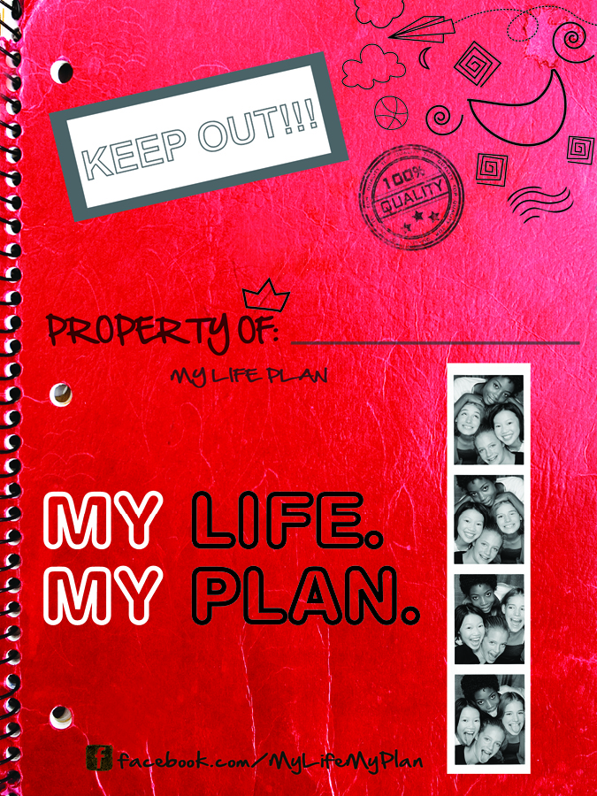

This book can help you
make a plan
that works for you!

Slide 3
Circle all the words that will describe your life when you’re 21.
Satisfying
Career
Sleep late
Joyful
Relationship
Dating
Family
Working
Independent
Dorm
Friends
Sports
Healthy
Busy
Calm
Make my own
decisions
Parenting
Education
Study
My own
apartment
Travel
Exciting
Successful
Volunteer
Easy
Relaxing
Notes:
Warm-up activity: “Life Words” handout.

Slide 4


1
Decide what you want from life.
Notes:
Ask the class: “What are some important questions to ask yourself when trying to decide what you want from life?
Examples: Do you want to go to college? What career are you interested in? Do you want to be in a relationship? Do you want a family someday?

Slide 5
Career
Education
Creative
Physical
Financial
Joy

Slide 6


2
Develop healthy relationships.
Notes:
Be in touch with your feelings and know what makes you happy. It might seem like everyone’s doing it, but they’re not. It’s perfectly ok not to have sex. And if your boyfriend or girlfriend pressures you or doesn’t understand, you don’t have to be with them. Are there people you can talk to when you’re feeling sad or stressed? Don’t be afraid to lean on a parent, relative or friend. And let them do the same.

Slide 7

Who do we have relationships with in our lives?
What are some qualities that
make relationships healthy?
Notes:
Ask the class for examples: friends, parents, family, siblings, coaches, teachers, doctors, extended family, peers, etc.
Universal qualities: respect, good communication, etc.

Slide 8

3
Make a Reproductive
Life Plan.

Slide 9
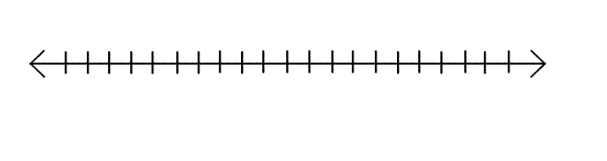
Your Lifeline
Let’s add some milestones to your lifeline:
Now, number
all the way up.
This is your Lifeline.
Age when you will get your driver’s license.
Age when you will graduate from high school.
Age when you will move
into your own house or apartment.
Age when you will finish your education.
Add your own milestone!
Put your current age here.
Place a star shape
anywhere on your line.
Age when you have a serious, committed relationship.
Age when you have your first child.

Slide 10
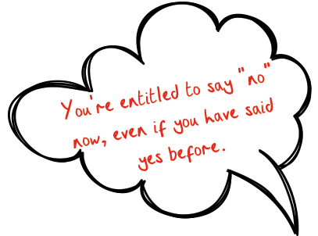
Abstinence (not having sexual contact) is the 100% most effective way to prevent pregnancy and sexually transmitted infections (STIs) .

Slide 11
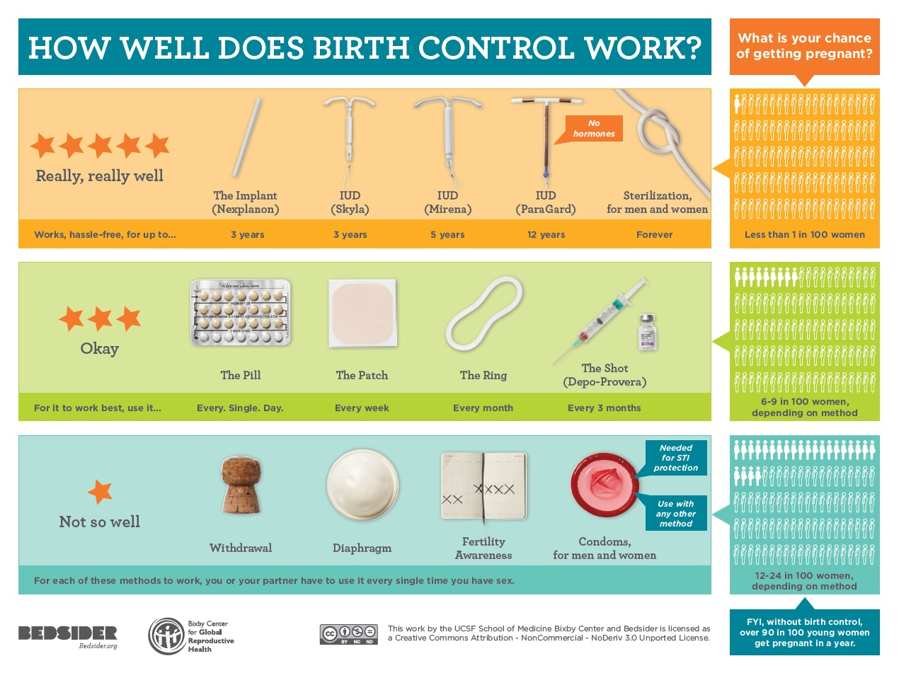

When people choose to have sex, it’s important to talk to a trusted adult about the best ways to reduce your risks for sexually transmitted diseases and pregnancy.
https://bedsider.org/methods

Slide 12


4
Live a healthy life.
What can people do to be healthy?
Notes:
Brainstorm ideas

Slide 13
Eat a healthy diet.
Exercise 3-5 times per week.
Stay away from alcohol, smoking,
and illegal drugs.
See your healthcare providers
for regular checkups.
Learn your family history.

Slide 14
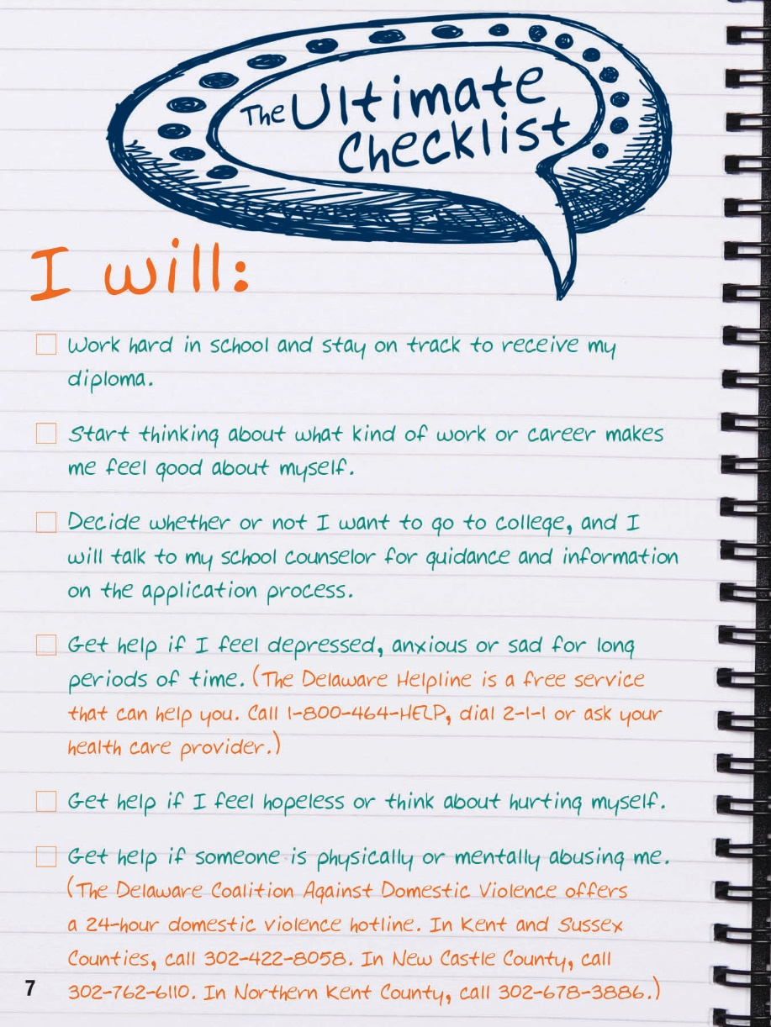
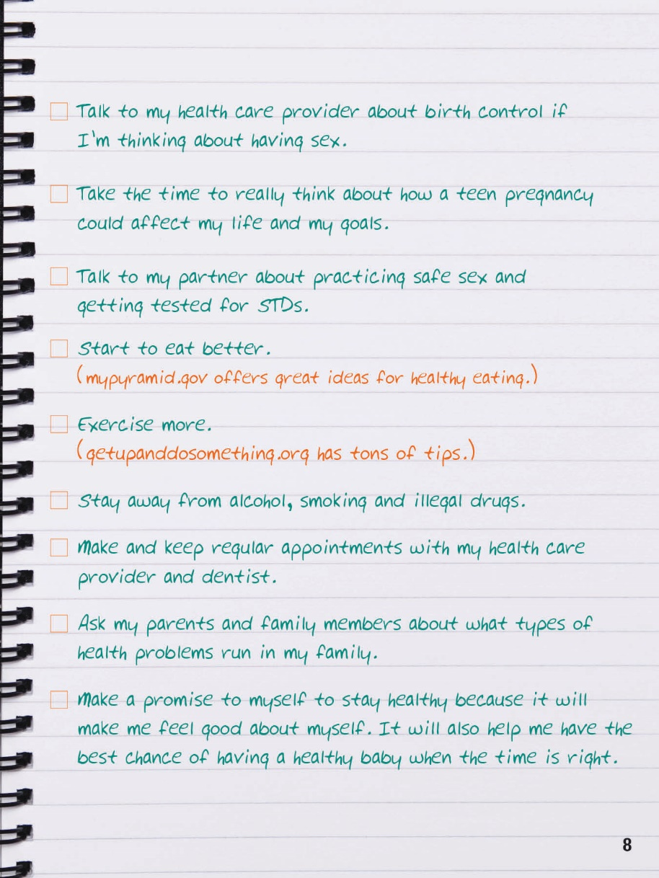
Check off the ones that are important to you:

Slide 15







Young Men’s Health

Slide 16
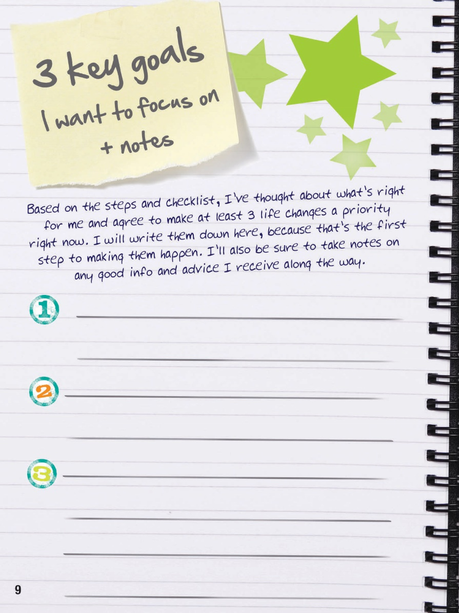
Time to set
some goals!

