Slide 1
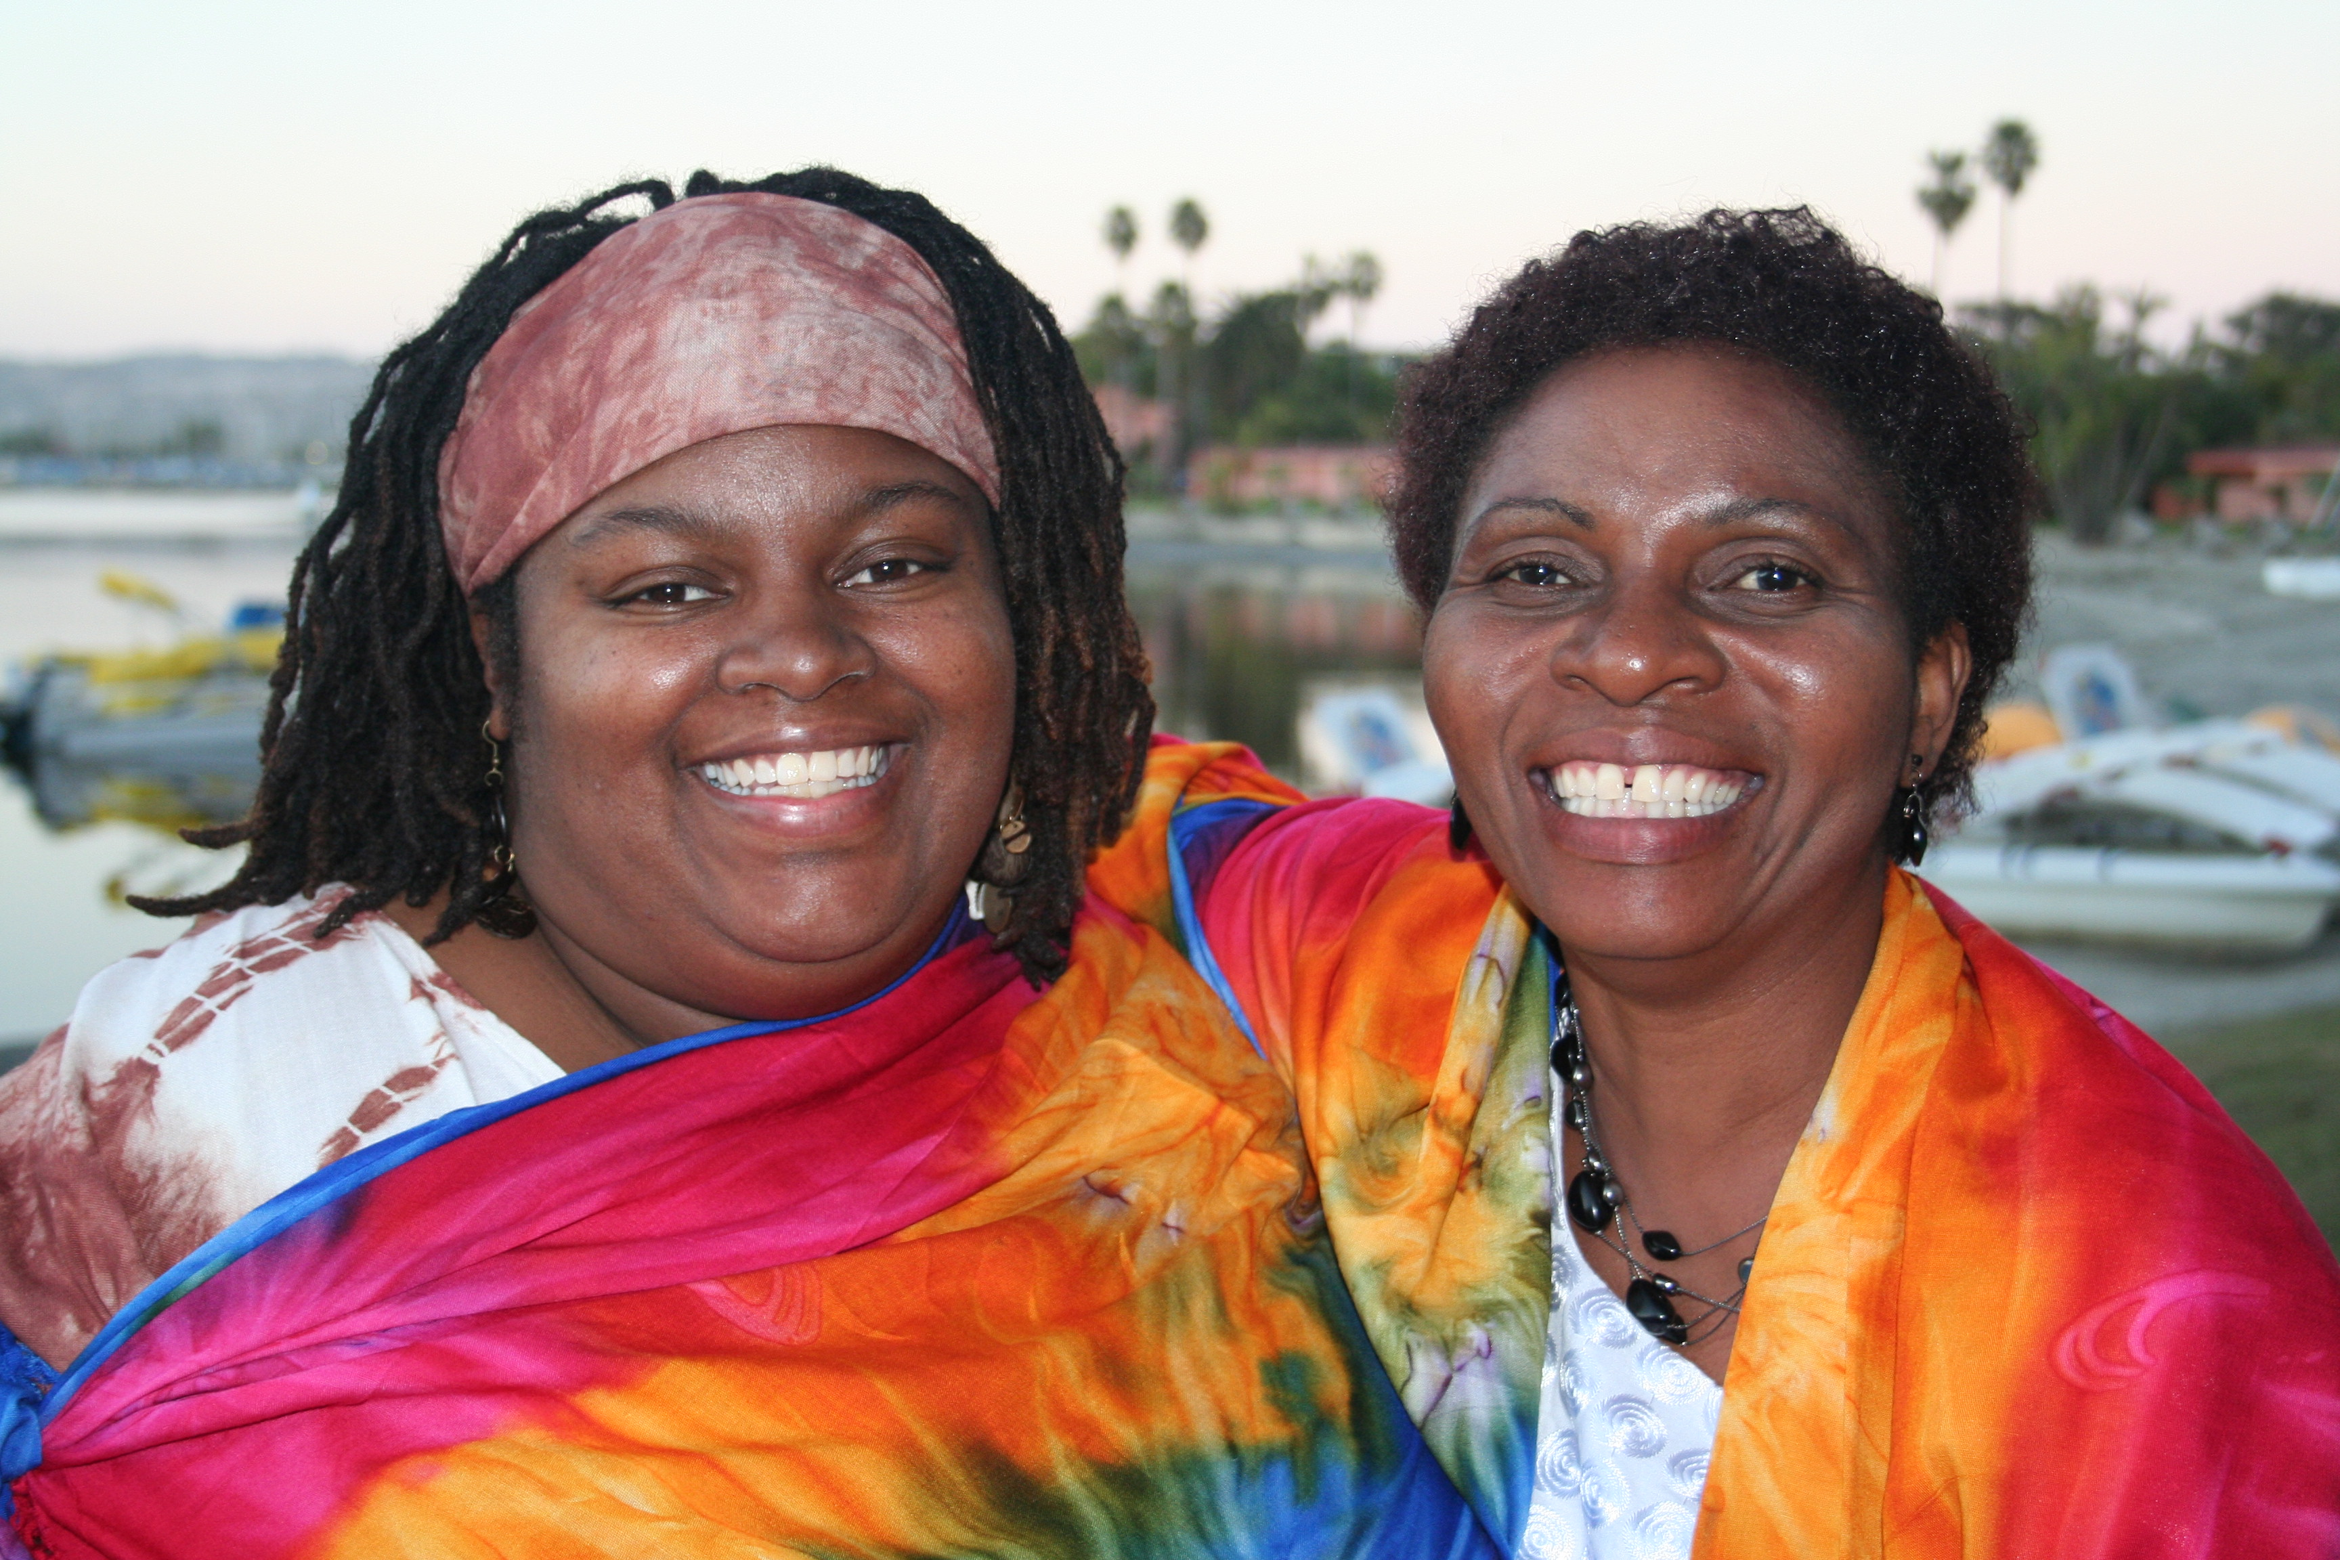
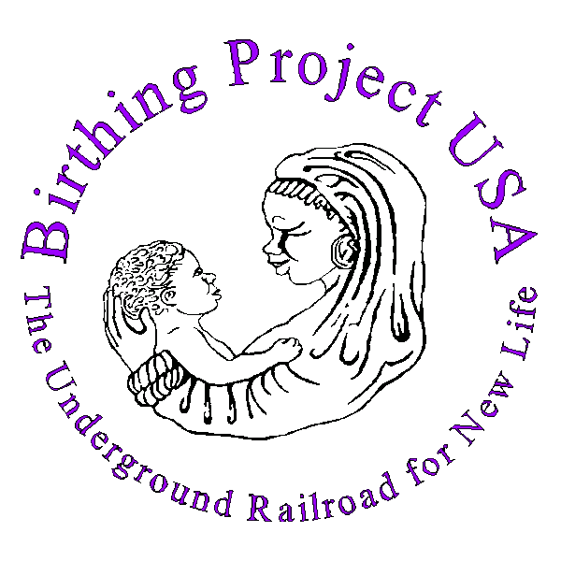
Birthing Project USA
The Underground Railroad for New Life
Picking up Passengers from Mississippi to Malawi
The Community as a Source of Healing

Slide 2
A Grassroots Effort to Improve Maternal & Infant Mortality and Morbidity
One-on-one social support, guidance and education provided by volunteers to assist pregnant women in accessing, understanding and participating in prenatal care and other critical resources during pregnancy and their child’s first year of life.
This solution has a 26 year history of working for women who are at risk of poor birth outcomes due to lack of income and education, social and or family support or displacement, e.g. refugees, environmental crisis or relocation.
Over 13,000 babies have been born in 7 countries.

Slide 3
The causes of Maternal and Infant Mortality and Morbidity according to grassroots, neighborhood and village women leaders in the Birthing Project include:
Systemic, Programmatic, and Personal Barriers to Care
The unknown
Health care system in a vacuum
Lack of access to information, education, and health care.
Lack of transportation
Stress: Too many issues to isolate or prioritize
Acceptance of poor birth outcomes as inevitable
Need for more coaches or perinatal support
Impact of individual and collective sense of
not being valued or precious
Lack of sense of belonging
Lack of sense of power

Slide 4
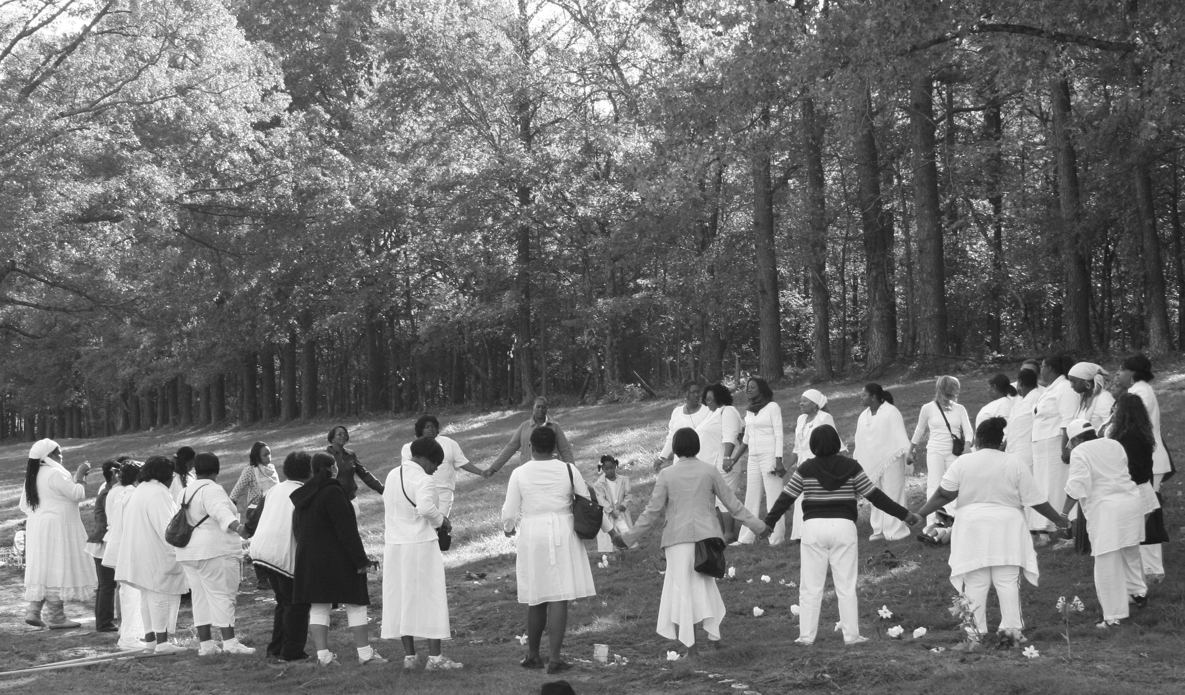
Babyland, Memphis, Tennessee
BUT…Mostly the lack of inclusion of the communities impacted in defining the problems and the solutions!

Slide 5
Our Piece of the Quilt: Community!
A. Re-member and re-establish culturally competent concept of extended family & community support for mothers, babies, and families.
B. Mobilizing community volunteers to create small groups of sisterfriends, volunteers to provide one on one support.
C. Expand our circles beyond our neighborhoods to reach our communities nationally and globally.

Slide 6
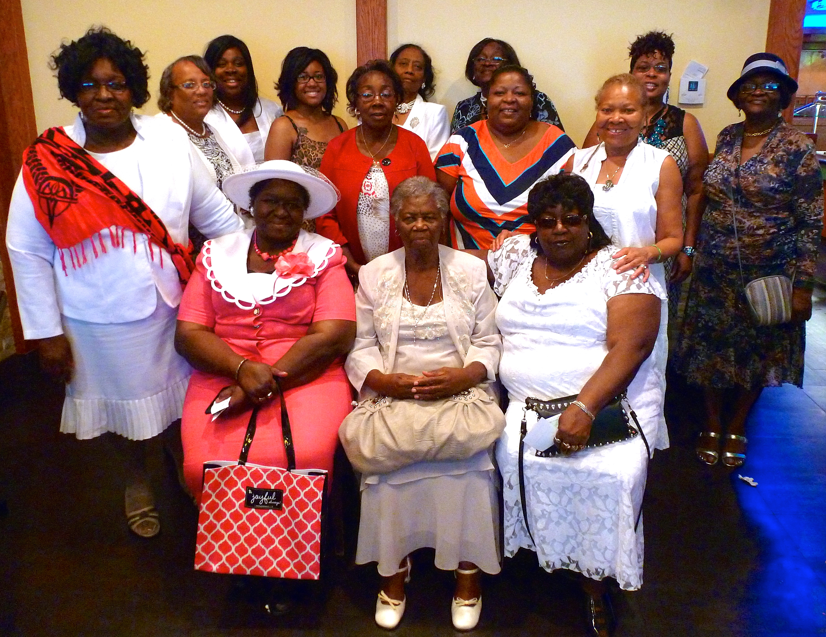
It’s about community!

Slide 7
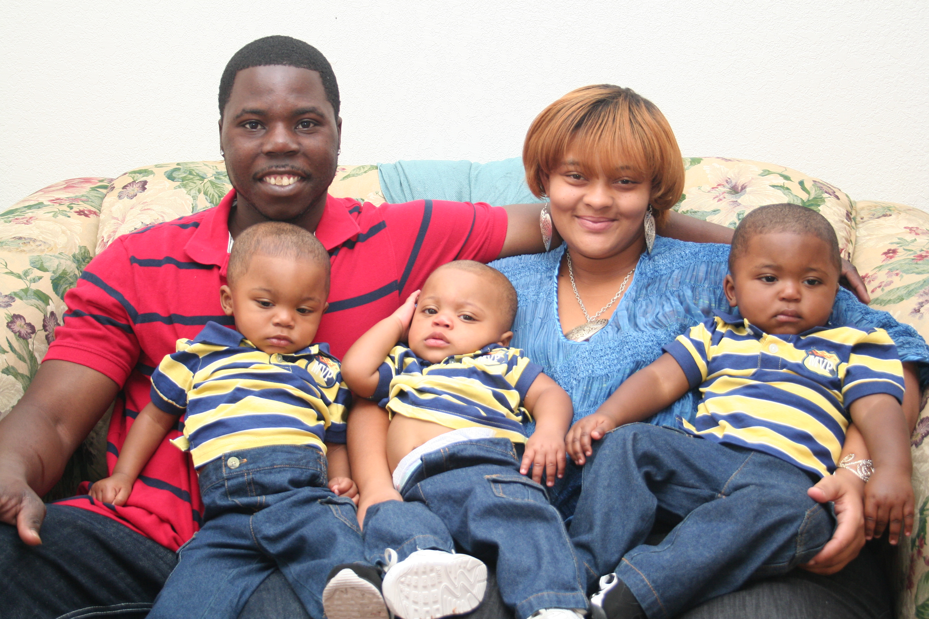
It’s about Family!

Slide 8
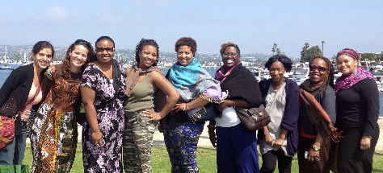
It’s about our next generation of community leaders…

Slide 9
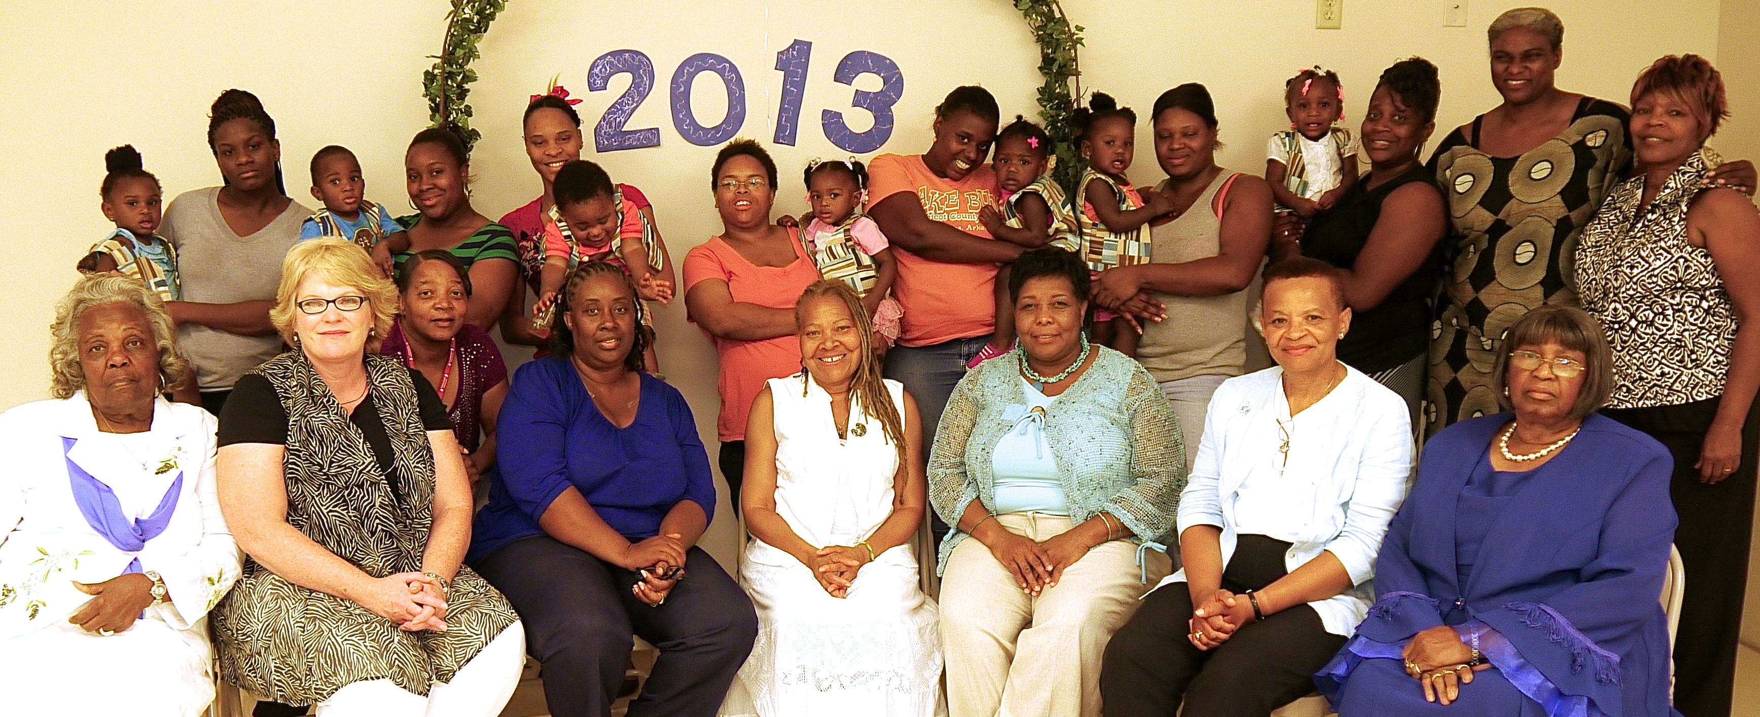
It’s about community!
Arkansas “Footsteps to Freedom Birthing Project” Baby Shower

Slide 10
Learning from Cuba: Best country for Black babies to be born
A. Universal Health Care Provided
in Every Neighborhood.
B. Services Not Eligibility-Based
C. National Culture Supporting
Breastfeeding

Slide 11
We have reached our Goal !

Slide 12
Learning from Birthing Project USA
2016 National Conference & Training
San Diego, California USA

Slide 13
We are Improving Health Status for Families
Co- creating a system of care
Sharing power and information
Being more inclusive
Re-visioning our sense of community

Slide 14
The Investment in Health Care Prevention, Intervention and Service is Enhanced, Leveraged, and Assured by Community Involvement & Support

Slide 15
Harriet Tubman Theory…
each person does the part they
can do, some people can take
a group from Tennessee to Canada,
some can only take a message to
the next Plantation, everyone
is a conductor…
…the magic of the Birthing Project…

Slide 16
Kathryn Hall-Trujillo, MPH
Birthing Project USA
Founder
www.birthingprojectusa.org
khalltrujillo@gmail.com
Presentation & Photography
Arnold Trujillo
BPUSA Media Specialist

