Slide 1
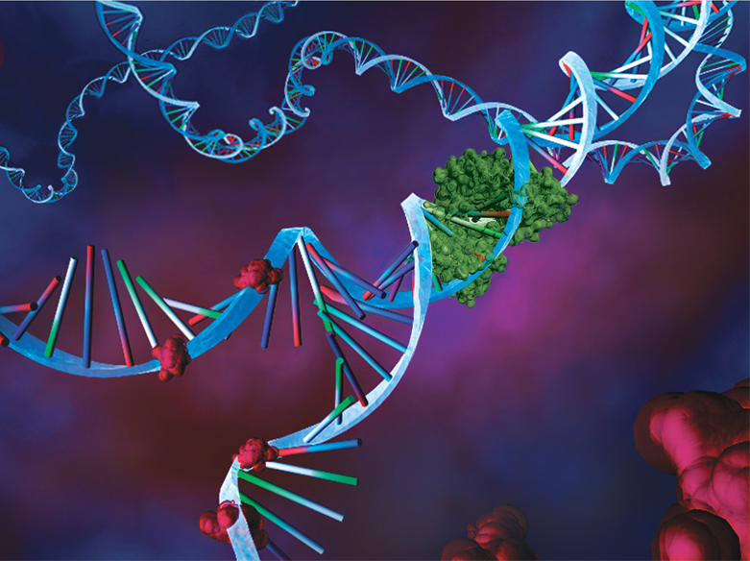
Getting Into Your Genes Another way to have a [healthy] baby!

Slide 2
What are genes?
Genes are made up of DNA
Genes carry in the information for cells to make a specific part of what makes you, you!
There are genes for making your skin, your hair, your heart, etc….
Genes are packaged within chromosomes which are passed on from parent to child.
Chromosomes are like a Book of Instructions
We all have two sets of chromosomes

Slide 3
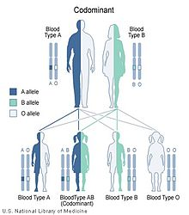
How are genes passed on?
We get one set of chromosomes from our Mom, and another set from our Dad.
So we have two Books of Instructions, with one usually acting as a backup.

Slide 4
How can a child get a Genetic Disorder?
One gene might have an error, like a misspelling in the set of instructions.
When the parents both have one bad copy, there is a 1 out of 4 chance that a child will be born with both bad copies.

Slide 5
What can you do?

Slide 6
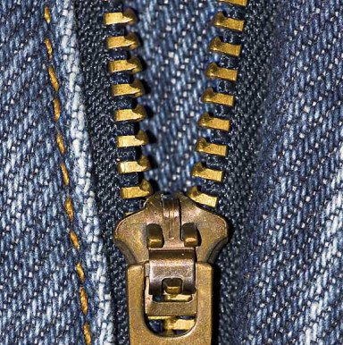
Unzip your family history!
Ask yourself certain questions about your family’s medical history, expecially with pregnancies.

Slide 7
Questions to consider:
Ask yourself if any of your relatives have had:
A baby born before 37 weeks (too soon)
A baby who weighed less than 51/2 pounds when it was born (too small)
Pre-eclampsia (high blood pressure during pregnancy) or eclampsia (seizures while pregnant)
Diabetes or gestational diabetes
Two or more miscarriages
Problems getting pregnant
A stillborn baby (a baby that was not alive when it was born)
A baby with a birth defect
Depression before or after the baby was born
Asthma
Heart or lung disease
A stroke
A known genetic disorder

Slide 8
Ask your Doctor!
Notes:
Doctor can give you advice on your chanced of having a child with a genetic disorder or complication. A doctor can also give you other reproductive plans, like Better monitoring through amniocentesis, or in vitro fertilization… etc.

