Slide 1
EXERCISE & YOU
Why exercise?

Slide 2
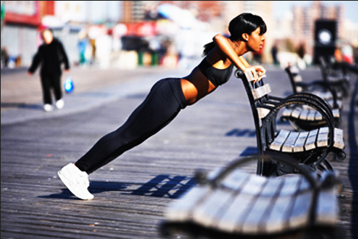
How often do you exercise?

Slide 3
Why should you exercise?
Some of us are aware that we should engage in “moderate intensity” exercise at least 30 minutes a day, 5 days a week
For a lean & fit physique
To be “Heart Healthy”
To excel in sports
But what other benefits can you get from regularly exercising?

Slide 4
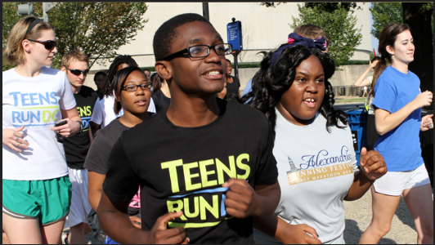
Health Benefits of exercise
Healthy Body Composition
Improve your Bone Mineral Density

Slide 5
Did you know exercise can also…
Positively affect your mood
Reduce stress
Improve your memory and brain power
It can even enhance your skin complexion!

Slide 6
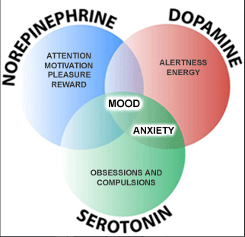
Exercise & Your brain…

Slide 7
Exercise can help your skin?!...
yes, it’s a natural AND free skin treatment!
Increased blood flow
Delivery of more nutrients
Ridding of waste products

Slide 8
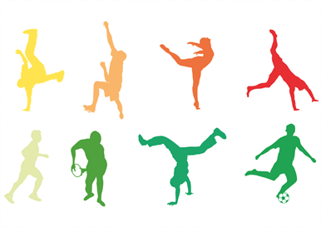
So, how will you exercise?

