Slide 1
Birth Spacing
Jessica Desrosiers and Elizabeth Santangelo

Slide 2
What is Birth Spacing?
Birth Spacing is the practice of waiting between pregnancies.
After having a baby, it is a good idea to wait 18-24 months before getting pregnant again to maintain the best health for a woman’s body and her children.
When the time between pregnancies is less than 18 months, her body may not be ready to have a healthy baby.

Slide 3
Target Audiences
Adolescents
Newlyweds
Postpartum Women
Women age 30 and older

Slide 4
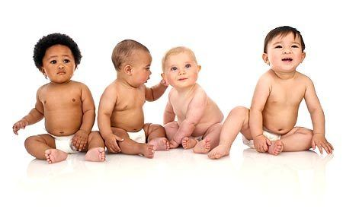
Why is Birth Spacing Important?
Increased risk of having a poor birth outcome
Threaten the health of the child and the mother
Associated with infant mortality and other short-term and long-term health complications

Slide 5
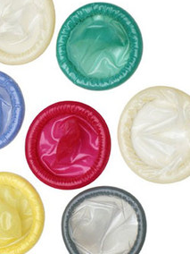
How Can Birth Spacing Be Accomplished?
Avoid having sex during the fertile days of a woman’s cycle
Barrier method of birth control, such as the male or female condom
Medication or hormonal method, such as birth control pills
A woman’s health status, body mass index, habits, and other considerations are all important factors in choosing a contraceptive method

Slide 6
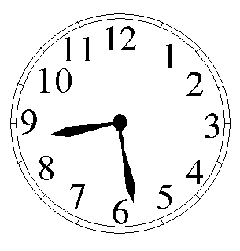
HEALTHY TIMING AND SPACING BEHAVIORS
Timing
Pregnancies delayed until 18 years of age
Pregnancies occur before age 34
Spacing
Pregnancies spaced to occur 18-24 months after preceding live birth (a 33 month birth-to-birth interval)
Pregnancies spaced to occur 6 months after miscarriage or induced abortion

Slide 7
Too Short Pregnancy Intervals are Associated with Multiple Adverse Outcomes
Perinatal/Infant Outcomes:
Pre-term birth
Low birth weight
Small size for gestational age
Still birth
Newborn/infant mortality
Maternal Outcomes:
Maternal mortality
Induced abortion
Miscarriage

Slide 8
What are the risks of spacing pregnancies too close together on mothers?
The placenta partially or completely peeling away from the inner wall of the uterus before delivery (placental abruption)
The placenta attaching to the lower part of the uterine wall, partially or totally covering the cervix (placenta previa), in women who previously had a C-section

Slide 9
Nutrient loss and birth spacing
Some experts believe that closely spaced pregnancies don't give a mother enough time to recover from the physical stress of one pregnancy before moving on to the next. For example, pregnancy and breast-feeding can deplete your stores of essential nutrients, such as iron and folate. If you become pregnant before replacing those stores, it could affect your health or your baby's health.

Slide 10
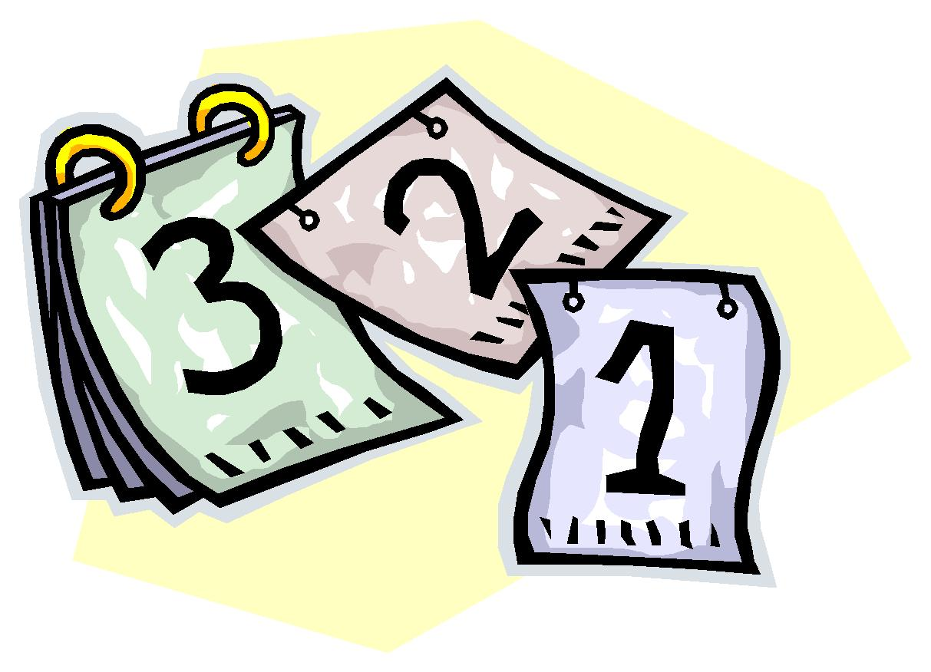
Birth after 24 months
When pregnancy occurs more than 24 months after a live birth:
Allows infant to benefit from two full years of breast feeding

Slide 11
Thank You!

