Slide 1
Reproductive Life Planning:
A Tool Kit for Service Providers
Philinda Mindler, MSW
ARC Counselor/Educator

Slide 2
http://dethrives.com/teens/

Slide 3
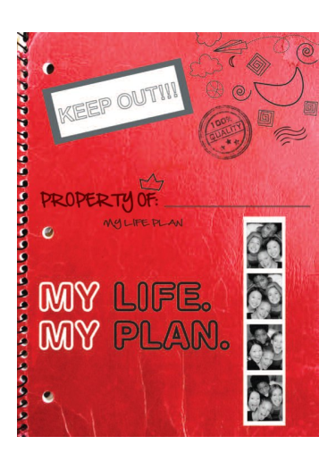
This book can help you
make a plan
that works for you!
Notes:
The My Life My Plan booklet is a really useful tool to discuss reproductive life planning with the adolescent population. One on one, in a classroom in small groups, in a bigger group setting

Slide 4
1
Decide what you want from life.
Notes:
Getting clients/students to think about what they want their life to be like can be the first step in making a life plan.

Slide 5
Notes:
One strategy is to use a vision board. Provide students with clippings from magazines, interesting text, and craft supplies so that they can make a vision board

Slide 6
Use Word Collections
Circle words that describe life attributes
Use cards and have clients select and order
Have words on slips of paper, clients can select, order and paste down
Use software to create a word activity
Notes:
You can use Word Collections
Provide a worksheet filled with applicable words and phrases
Creat word/phrase cards and cut out and laminate them if you want to reuse them
Have words available on slips of paper or for clients to cut out. They can select, order and paste them down
Use software such as on a touchscreen for clients to create a lesson

Slide 7
Choose the words that will describe your life when you’re 21
Calm
Make my own
decisions
Parenting
Education
Study
My own
apartment
Travel
Exciting
Successful
Volunteer
Easy
Relaxing
Satisfying
Career
Sleep late
Joyful
Relationship
Dating
Family
Working
Independent
Dorm
Friends
Sports
Healthy
Busy
Notes:
This Word Collection worksheet is available on the Delaware Thrives website

Slide 8
Open Ended Questions/Sentences
I would like to finish…
By the end of the year I would to…
One thing I would like to change about my life is…
I’d like to have enough money to…
I’d like to be the kind of friend who…
One place I’d like to visit is…
Notes:
Provide open ended sentences for clients or ask/interview or have students interview each other in pairs

Slide 9
Use Structured Sharing
Pair and Share
<a href="http://www.freepik.com/free-photos-vectors/light">Light vector created by Freepik</a>

Slide 10
Notes:
Setting goals is an important skill to help adolescents work on

Slide 11
Career
Education
Creative
Physical
Financial
Joy
Notes:
Discuss life areas- when people are deciding what they want their life to look like, what are some things that they might think about?

Slide 12
Some Ways to Discuss Goals
Wish vs. a Goal
Use an imaginary person and create a goal for them
Have a pair or small group create sample goals
Discuss breaking a goal into attainable steps
Notes:
What is the difference between a goal and a wish?
Sample goal setting- no pressure, use an imaginary person
Ask a pair or group to come up with a sample goals
Breaking goals into smaller steps

Slide 13
Goal Areas
Career
Education
Creative
Physical
Financial
Joy
You are going to create some goals for “Alex” a 7th grader
A. choose 2 life areas and write one goal for each
Example: Goal: Physical
Specific Goal : Get on the track team
Goal area ____________________
Specific Goal __________________________
B. Help Alex take steps to reach the goal. Add 2 steps that would help Alex get on the track team.
Specific Goal: get on the track team Step 1 practice running 3 x a week
Step 2 _______________________________________________
Step 3 ________________________________________________
Step 1 _______________________________________________________
Step 2 ________________________________________________________
Notes:
This is available on the Delaware Thrives website

Slide 14
2
Develop healthy relationships.
Notes:
What is a relationship? Who do we have relationships with?
Ask students about what are some things that make relationships healthy
Play a healthy characteristic game:
Use characteristic cards, pass them out randomly and discuss how people decide what they like or don’t like
Or have students create their own and discuss
Emphasize traits of a healthy relationship- trust,

Slide 15
3 Make a Reproductive Life Plan.
Notes:
Can people decide when they want to become a parent or how many children they will have?

Slide 16
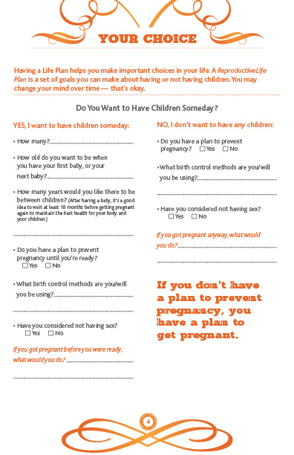
Would you
like to create a pregnancy in
the next year?
Notes:
This is from the adult life plan but this page can be copied or reformatted for classroom use.

Slide 17
Your Lifeline
Let’s add some milestones to your lifeline:
Now, number
all the way up-
This is your Lifeline
Age when you will get your driver license
Age when you will graduate from high school
Age when you will move
into your own house or apartment
Age when you will finish your education
Add your own milestone!
Put your current age here
Place a star shape
anywhere on your line
Age when you have a serious, committed relationship
Age when you have your first child

Slide 18
Eat a healthy diet.
Exercise 3-5 times per week.
Stay away from alcohol, smoking,
and illegal drugs.
See your healthcare providers
for regular checkups.
Learn your family history.
Notes:
You can emphasize any or all of these point and use lesson plans to help

Slide 19
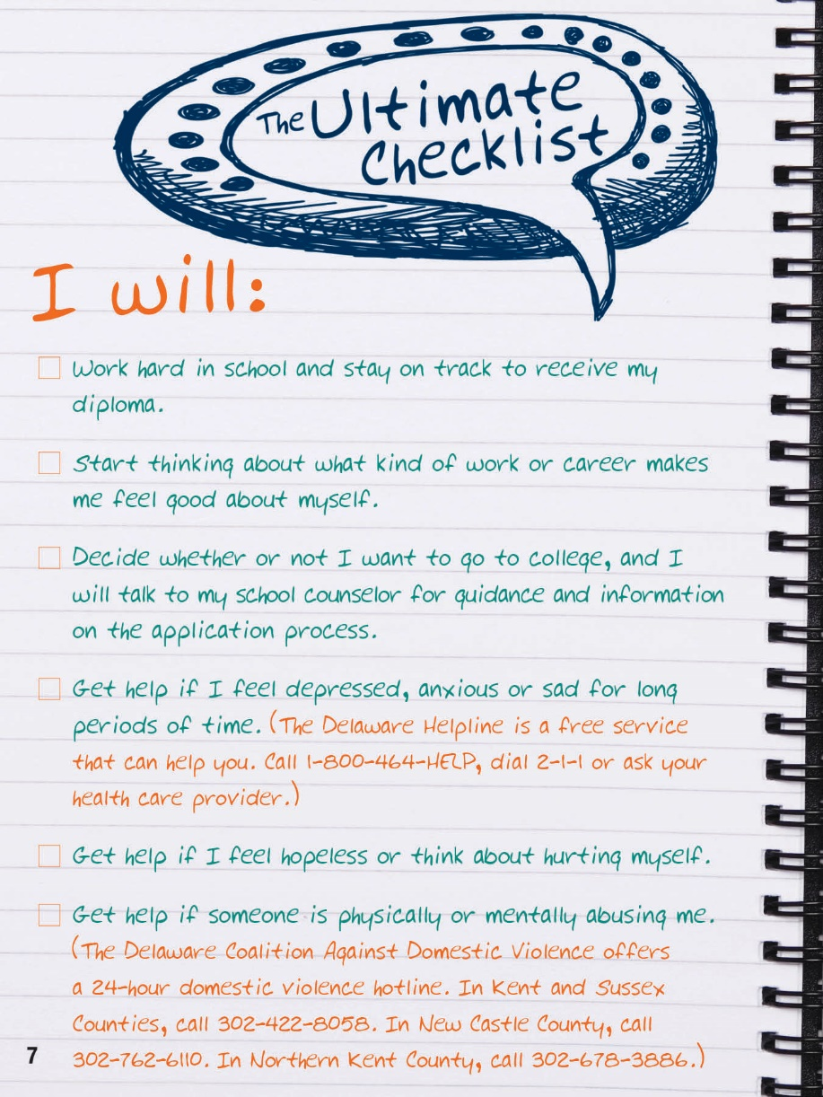
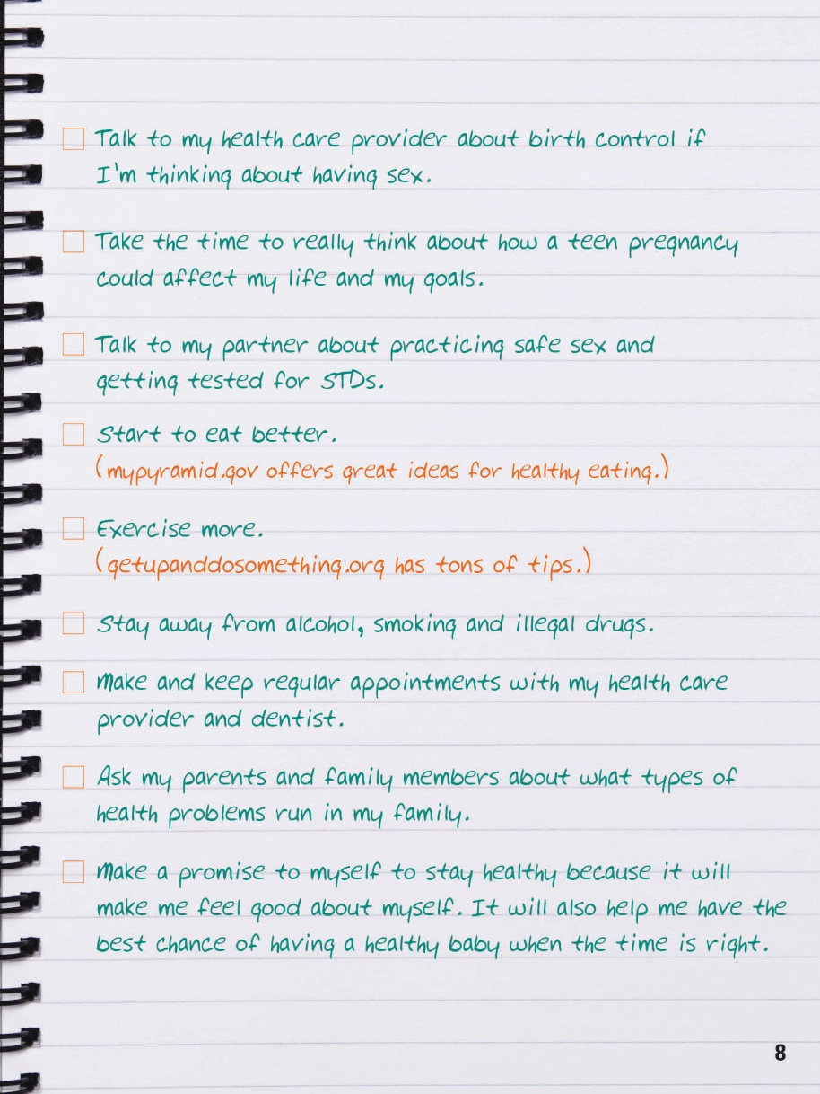
Check off the ones that are important to you:

Slide 20
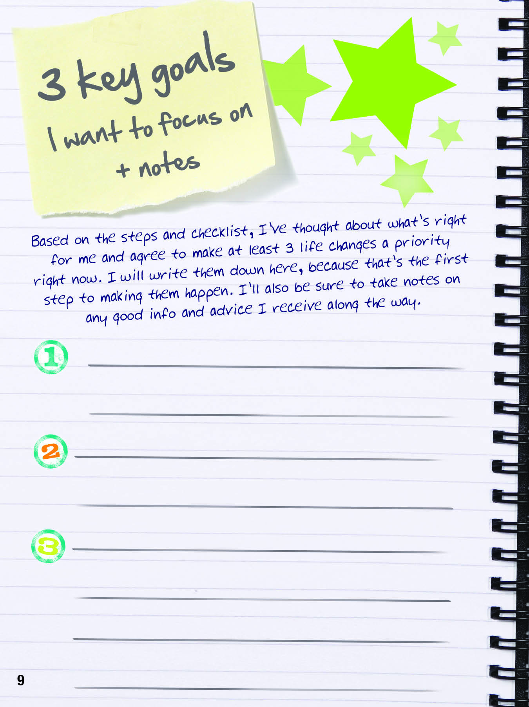
Time to
set some goals!
Notes:
Ask student set some goals for themselves

Slide 21
Young Men’s Health

